Slide 1
So you want to be a Data Engineer?
Notes:
So you want do be a Data Engineer Right?

Slide 2
Why are you here?
Notes:
Maybe but maybe just not yet

Slide 3

Notes:
So hopefully we’ll already have a few of you guys hear who have already had look into this, you’re learning some of the skills been to some session this week and thought lets do this

Slide 4
“Just a developer that happens to focus on data”
“Just a glorified ETL Developer”
BI Developer
Software Engineer
“A cog in the data science process”
Data Engineer
“But we already built a Data Warehouse”
Data Scientist
DBA/DRE
Notes:
Or maybe you just don’t not know what a Data Engineer is or does?
We find that we’re even not that well known by our peers within the Data Industry
We talk to you guys all the time and quite often the initial opinions of who we are and what we do are vary to say the least
Data Scientists often see us in there world as part of the Data Science process
*Click
Bi Developers, and these guys are not alone, see us as glorified ETL developers
*Click
Software Engineers recognising us with our coding heads on think we’re a developer that focus on data
*Click
Then we have DBA’s and Database Engineers, these guys may have already built many of the platforms or even the data warehouse you’re using today within your organisation and are probably wondering what we’re doing in there world
During this session we’re going to address some of the misconceptions out there

Slide 5
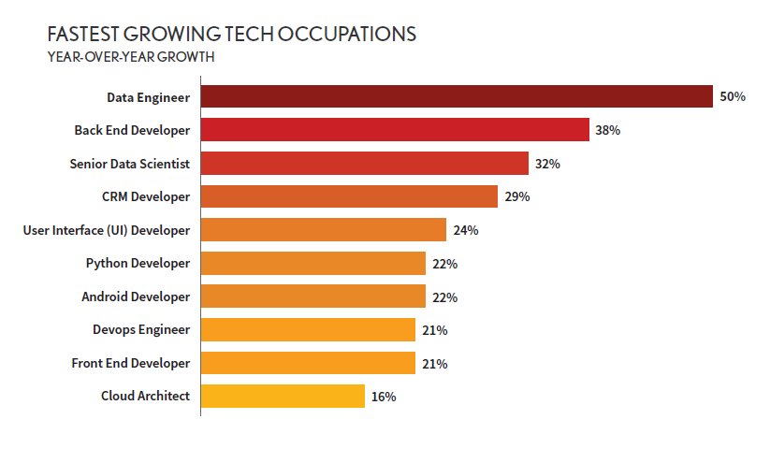
Notes:
Data Engineer is growing, and is growing fast
The simple fact of the matter is that Its under resourced and a highly sort after skill set within the data field, this particular survey has Data Engineering as the fastest growing tech occupation with year on year growth of over 50%, obviously we like this graphic as it puts us top many other surveys including those directly focused at data science identify data engineering as the role with the best job outlook of all the data roles, look for yourself Linkedin and Stack Exchange
And obviously high demand means greater salary potential

Slide 6
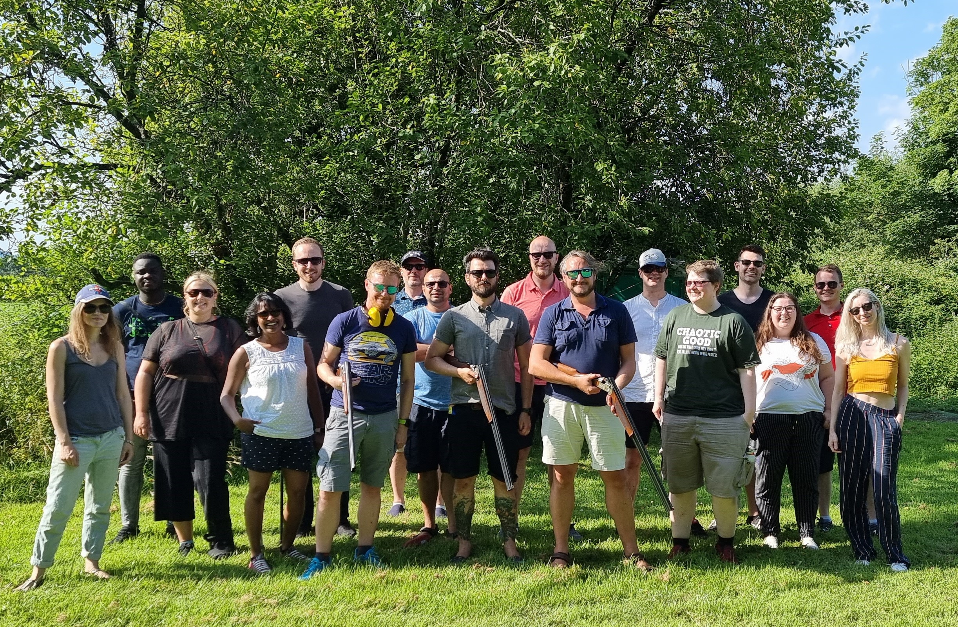

The BI and Data Generalist
The Bi and Data Generalist
The Software Engineer
The DBA
The DBA
Notes:
Why are we the team to help you today,
We’re all data engineers at a Data Engineering and Data Science consultancy
**click
And we’ve made that transition from another area of the data world into Data Engineering
We have Anna, our software Engineer, is a Senior data engineer but her passion is in coding, she our self styled code cops and has made us all better programmers which is no small achievement in itself
From the world of BI and General Data – we have Ust, Ust is one of our Principal Consultants, he’s going to disprove my own fairly shallow misconception that Bi folks just love Excel, without admitting truly is a n Excel fanboy
And me Mikey the DBA, as well representing the cool kids I’m also a senior data engineer and I’m presenting for the first time today, so just wanted to give a quick shout out to the community because being one of you guys for the last 10 years has got me up here doing this today

Slide 7


Data Engineering… It’s FUN
Notes:
Lastly data engineering is fun and you want to come to work to have fun right, we think we’re very lucky to work with new tech daily and work on solving new problems using data
Although we have to admit some days it’s like wrestling a bear and an alligator at once

Slide 8
How are we going to help
What is Data Engineering
The Tools and Technology
How we Got Here
Notes:
To hopefully get you started on you own journeys we’ll be breaking the session down into 3 sections
We’re going to introduce the role of the data engineering
We’ll introduce some of the tools and technologies we use and
And we’re going to show you just how accessible it is for other tech professions by telling you our own stories

Slide 9
How are we going to help
What is Data Engineering
The Tools and Technology
How we Got Here
Notes:
To hopefully get you started on you own journeys we’ll be breaking the session down into 3 sections
We’re going to introduce the role of the data engineering
We’ll introduce some of the tools and technologies we use and
And we’re going to show you just how accessible it is for other tech professions by telling you our own stories

Slide 10
What is a Data Engineer?
Notes:
Mikey 5 mins
First up, what is a data enginner

Slide 11
BI Developer
Warehousing
Kimball
Data Quality
Software Engineer
Architecture Design
DevOps
Agile Development
Data Scientist
Big Data Tools
ML Engineering
Exploratory Analysis
DBA
Build Data Platforms
SQL
Performance & Security
Data Engineer
Notes:
So earlier we identified a group of roles or persona’s with the data industry, each of these has a number of skills that make them important to delivering and managing data solutions
A data engineer will have many of these skill and will also be an expert in some of them

Slide 12
?
BI Developer
Software Engineer
Data Engineering Team
Data Engineer
Data Scientist
Data Scientist
DBA
Notes:
Infract the data engineer, is a combination of parts of all these rolls, Data Engineers come from many different backgrounds and it’s a very wide role each brining different specialties and skills ranging from the data heavy roles such as BI to those heavily invested in Spark and Massively Parallel processing systems, Data Engineers often come with backgrounds in Kubernetes and open source backgrounds.
Now there might be a worry that data engineers are replacing current data teams, absolutely not, this is an evolution to provide businesses and teams with more opportunities, our aim as Data Engineers work in teams combining expertise and experience to deliver more complex data solutions

Slide 13
What does a Data Engineer do?

Slide 14


So is Data Engineering just about ETL (Extract Transform Load ) Pipelines?
Talks to stakeholders and decides best data architecture for given project
Work with a variety of professionals to accomplish goals, including:
Data Scientists
Software Engineers
Business Analysts
Notes:
So we’re not all about ETL pipelines although it is one of the key area’s in our role
we will build data processing and analytical pipelines but we will also optimize the flow of data and enable data at scale.
To do this data engineer will understand many technologies from data processing engines, storage and orchestration tools we also need to be able to develop our own tools to solve specific problems we may have in processing the data.
**click
We also need to understand the stakeholder requirements and be able to architect solutions based on these
**click
Data engineers also need to need to work with a number of roles to accomplish our goals wo work closely with teams such as data scientists software engineers and business analysts.

Slide 15



The Tools and Technology
What is Data Engineering
How we Got Here
Notes:
So we now have a picture of what a data engineer is, next we’re going to introduce some of the technologies and tools before moving into how we got here
I’m going to hand you over to Ust who is going to start to look at the Tools and Technology used in data engineering, over to you Ust

Slide 16
Where it all began

Slide 17
The Old World
Notes:
Ust 2-3 mins
In the old world, we had our enterprise data warehouse, which largely took from relational source systems and transformed data into our dimensional model

Slide 18
Package Orchestration
Master Package
Stage Tables
Create Dims
Create Facts
Notes:
Ust
This was all orchestrated using SSIS, or some other ETL tool, and would typically be a package per table per process, with some dependencies thrown in to help make it run smoothly

Slide 19
Our ETL Tool Checklist
Low Dev Effort
Many Use Cases
Flexible Formats
Elastic Scaling
Agile
Supportable
Notes:
Ust
But as ETL Developers, we want…
as little effort as possible in creating our processes
want to apply the same process to as many things as possible
And to do that across many different file formats and not just relational – or some super flakey flat file reader
And we want it to scale up and down, without the constraints of infrastructure
We want it to be agile and enable iterative development
And we want it to be supportable – so it can be picked up by almost anyone and not just deep experts
SSIS, and other on-prem tools, tick some boxes but not all. Therefore, it fails.

Slide 20
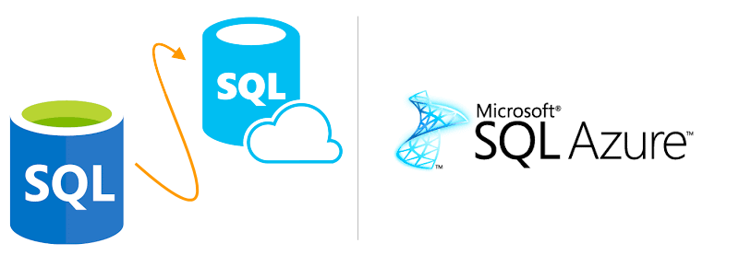


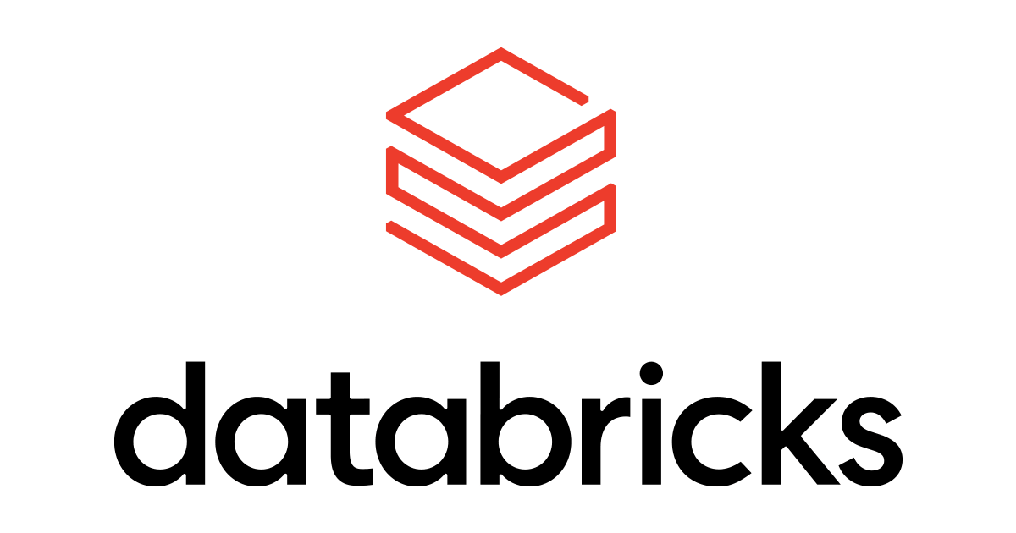

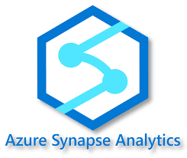



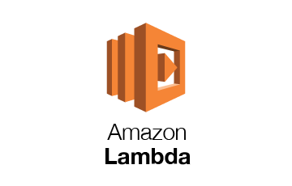



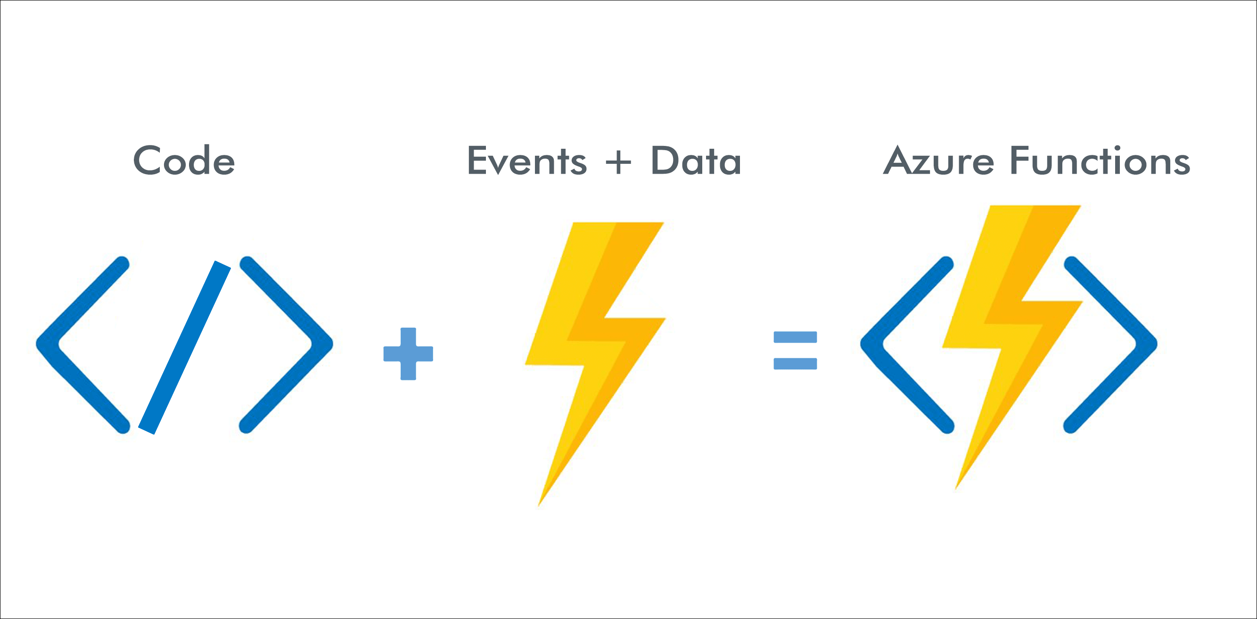
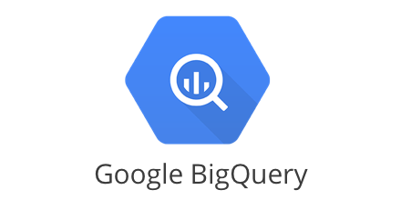

So We Move to the Cloud Right?
Notes:
Anna 10 mis

Slide 21
More realistically, we have several key options
Visual cloud-native Orchestration. Excellent at moving data between sources
Azure Data Factory
Azure Synapse Analytics
Spark as a service, powerful multi-language big data engine. Supports SQL but best with Python/Scala
Suite of tools ranging from orchestration to engineering & full data warehousing
Databricks

Slide 22
A Modern Architecture
Orchestration

Slide 23
Orchestration & Integration

Slide 24
An ADF Primer
Copy Data
Transform
Performs copy activities using it’s own scalable compute
Triggers other components for heavy lifting & intensive transformation
Azure Data Factory
Notes:
We focus on ADF

Slide 25
ADF IN AZURE
Transform Activities
Copy Data
Sources
Destinations

Slide 26
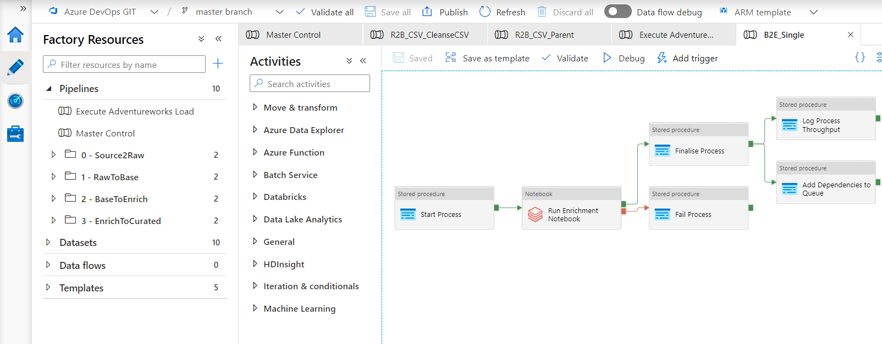
Developer Tools

Slide 27
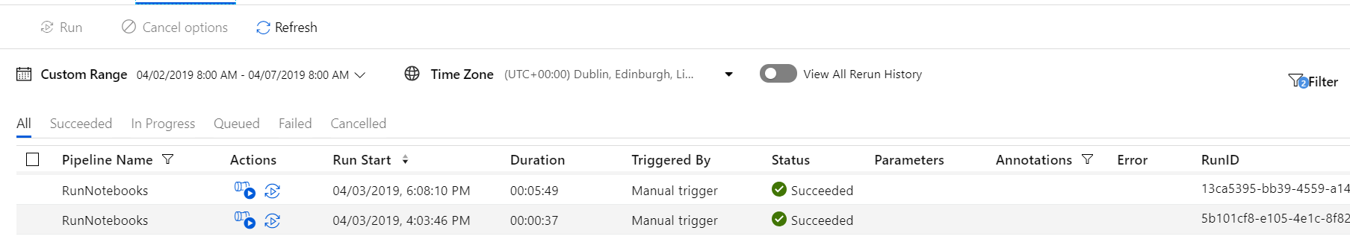
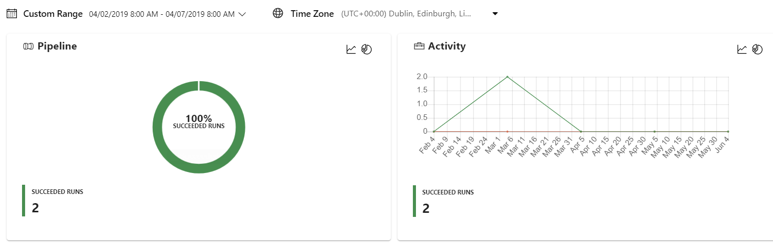
Monitoring

Slide 28
SSIS – Lift & Shift Potential
Pipeline
SSIS Activity
SSIS Catalog
SSIS IR

Slide 29
Use the Flexibility of Data Factory
Pipeline
Lookup Activity
ForEach Activity
select *
from sys.tables
Copy Table 1
Copy Table 2
Copy Table 3

Slide 30

Data Factory Recap
Orchestrates all data workflows in Azure
Best method of onboarding data to Azure
Use parameters, forEach and child executions
Low Dev Effort
Many Use Cases
Flexible Formats
Elastic Scaling
Agile
Supportable

Slide 31
Data Processing

Slide 32
Quick Spark Overview
Spark is a distributed, scalable data processing engine.
It can query structured and non-structured data
You can use Python, Scala, R, C# or SQL to interact with it
PYTHON

Slide 33
So What?
Create DataFrame
Add Calculated Columns
Remove Bad Rows
Write to Table

Slide 34
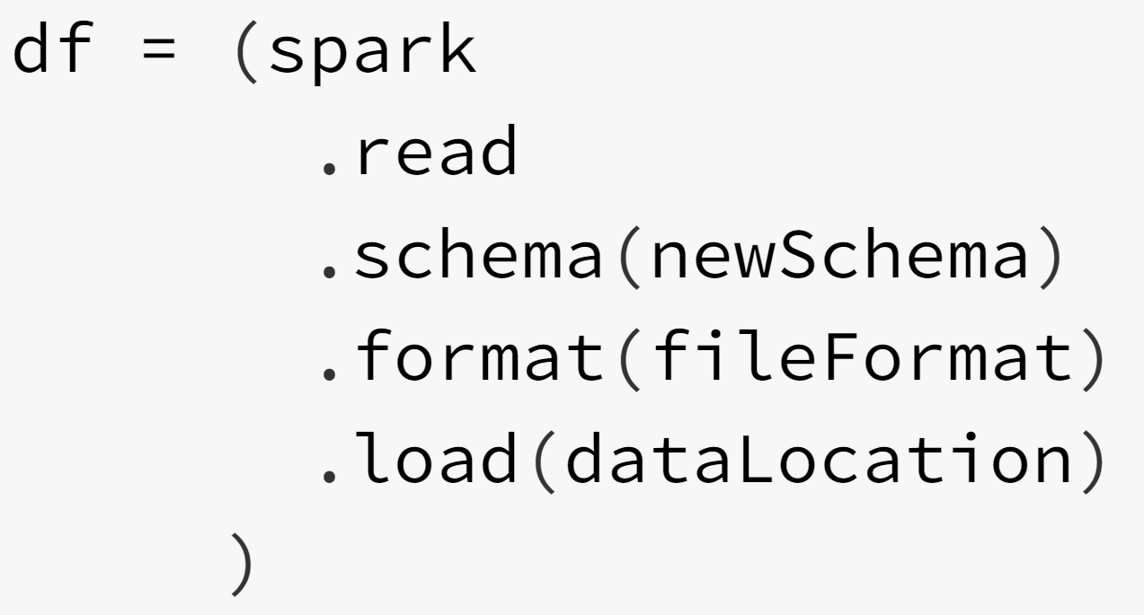
Inside a DataFrame
DataFrame
Schema
Format
Location

Slide 35
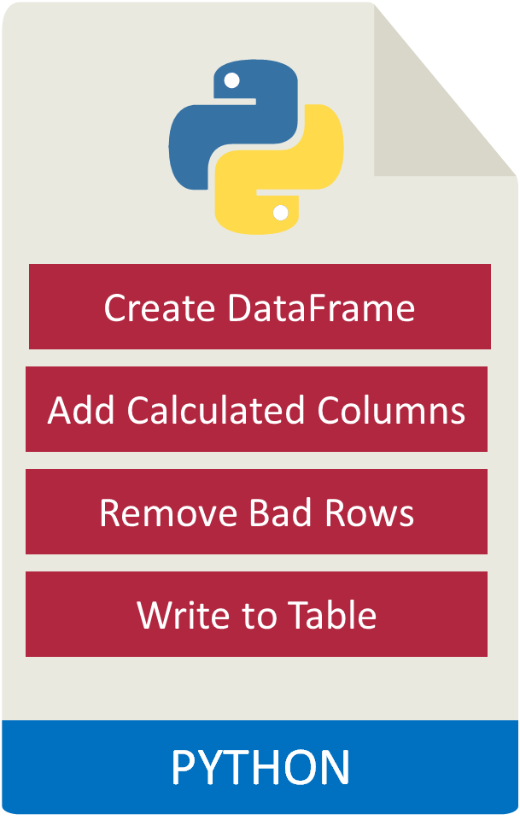
So What?
Path
Format
Schema
Notes:
Hand over to Mikey

Slide 36
Spark Options in Azure
Notes:
Mikey 5 mins

Slide 37
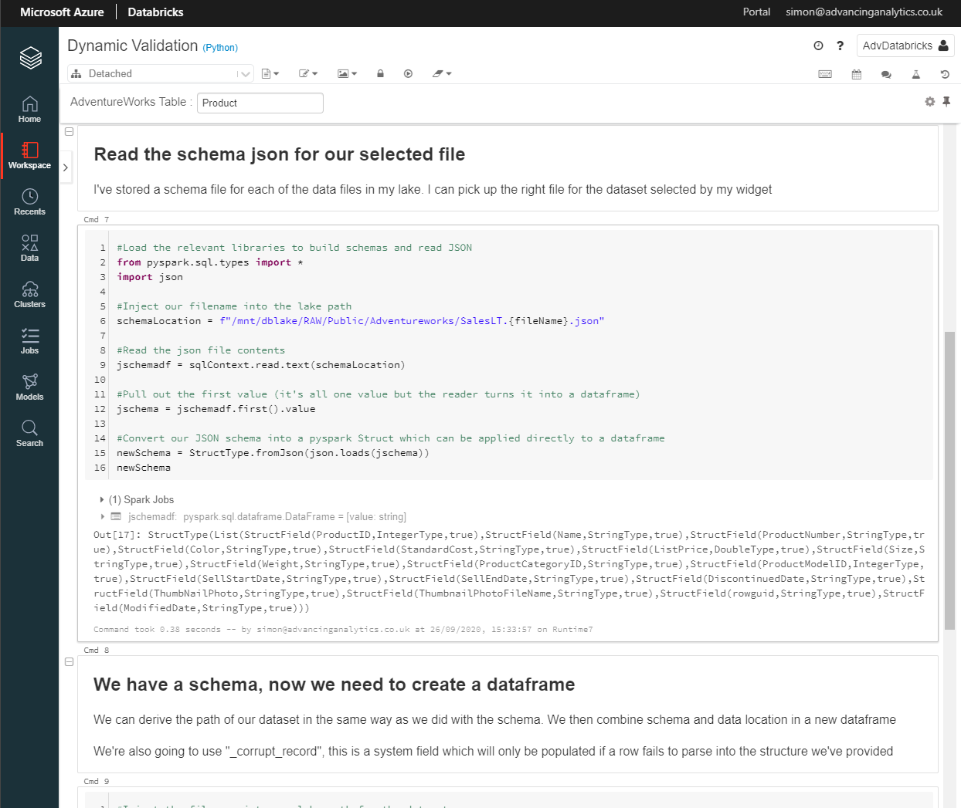
Azure Databricks
Notes:
Azure databricks is Data and AI service that is optimised for Azure, its tightly integrated with other services such as Azure data lake azure, azure data factory, azure machine learning, synapse and other azure services allowing you store your data on a single simple platform and unify analytics and AI workloads

Slide 38
Azure Databricks
Databricks is a third-party company, founded by the team who invented spark
They provide an Azure-native, managed Spark platform
Databricks will generally have the most advanced spark engine and maintain a fast release cadence
Notes:
Databricks is a third party company, founded by the team behind Apache Spark while at UC Berkley, Spark is an open source project that started in 2009, went open source in 2010 and was donated to Apache in 2013 and became Apache spark
Apache Spark is a framework for executing code in parallel across many different computers, Databricks is a hosted implementation of spark designed to simplify the management of clusters and interfaces to ensure production level stability of the Spark platform which can be challenging for many organisations. One of the advantages of Databricks over other spark based services it the Databricks will usually have the most upto date release of the spark engine and will maintain a fast release cadence of version.

Slide 39
Azure Databricks
The Databricks Workspace
Clusters
Notebooks
Libraries
Notes:
Databricks has a number of fundamental tools that you need to understand, the key tools
The workspace allows you to organise the work you are doing on Databricks, think of it like a folder structure on your computer it allows you to save and share notebooks and libraires with other users, the workspace isn’t connected to your data its simply a way to organise your code
Clusters in Databricks are groups of computers that you treat as a single unit, they allow you to excute the code in your notebooks, libraries or process data sets
Notebooks are collections of cells containing code to be executed, notebook cells can be written in python scarla sql r and makedown, to execute the code the notebook needs to be attached to a cluster.
Libraries are packages or modules that provide additional functionality that you need to solve your business problems. These may be custom written Scala or Java jars; python eggs or custom written packages. You can write and upload these manually or you may install them directly via package management utilities like pypi or maven

Slide 40
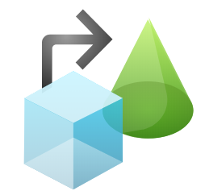


Azure Synapse Analytics
Data Pipelines
Mapping Data Flows
Azure Synapse Studio
Dedicated
SQL Pools (SQLDW)
Serverless
SQL Pools
Provisioned
Spark Pools
Monitoring
Data Lake Store Gen 2
Metadata
Store
Management
Notes:
Ust 3-5 mins
Synapse is this one stop shop for development, incorporating features from ADF like Data Pipelines and Mapping Data Flows
But also with Spark functionality – making it a well placed alternative to Databricks
It also includes different serving options, in Dedicated SQL Pools and Serverless SQL Pools – giving flexibility to engineering teams and users.

Slide 41
Azure Synapse Analytics - Spark Pools
Billed Per Session Uptime
Scala, Python, C#, SQL
Dynamic Workflows, Machine Learning & Unusual Data Types
Notes:
Ust

Slide 42
Serverless SQL Pools
Billed Per TB Read
T-SQL
Ad-hoc/Occasional access
Notes:
Ust
Good for ad-hoc / occasional access, but also for logical data warehouses where you don’t necessarily need the formality and structure of alternatives like Dedicated SQL Pools

Slide 43
Dedicated SQL Pools
Billed Per Hour
T-SQL
Huge Datasets & Formal Modelling
Notes:
Ust
This is more aligned to the traditional enterprise data warehouse model – where datasets are also HUGE.

Slide 44
Azure Synapse Analytics
Synapse Workspace Overview
Serverless SQL
Spark Pools

Slide 45
So Where does that leave us?
Notes:
Mikey 1 min

Slide 46
A Modern Architecture
Orchestration

Slide 47
What is Data Engineering
How we Got Here
What is Data Engineering
The Tools and Technology

Slide 48
Data Engineering vs Data Science

Slide 49

The two work hand in hand
A good Data Engineering Strategy means less data wrangling for Data Scientists
Notes:
Difference between two roles

Slide 50
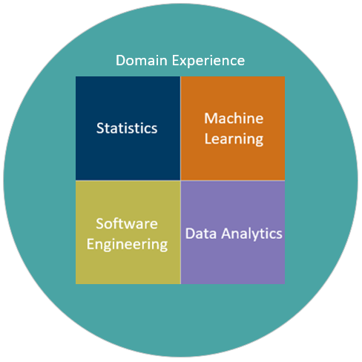
Data Science Teams
Statistics
Machine Learning
Software Engineering
Data Analytics
Critical to the success of any Machine Learning
is that the business domain is well defined and understood by the development team.

Slide 51
Hidden debt in ML Systems
Data Verification
Serving Infrastructure
Monitoring
Machine Resource Management
Configuration
Data Collection
ML Code
Analysis Tools
Feature Extraction
Process Management Tools
Only a small amount of the time spent on a Machine Learning project is spent writing Machine Learning code. The rest of the time is spent on supplementary tasks.
80% of Data Science is spent on the rest of this diagram. After applying the common Data Engineering approaches we can reduce this
ML Code
Scully et al, 2018

Slide 52
Hidden debt in ML Systems
Data Verification
Serving Infrastructure
Monitoring
Machine Resource Management
Configuration
Data Collection
ML Code
Analysis Tools
Feature Extraction
Process Management Tools
After implementing common engineering patterns the complexity in most areas are reduced. This can be reduced further with a standard approach to Machine learning deployments
Scully et al, 2018

Slide 53
Data Engineering vs BI
Notes:
Ust

Slide 54

The skill sets can be very similar, so what’s the difference?
Data Engineers need to understand data modelling but don’t necessarily have to implement data models:
Notes:
Ust
Report writing? Definitely not, or for your own purposes
Creating data models? Possibly…. Depends on the size of teams, but we’re often seeing this becoming a dedicated role in its own right

Slide 55
DBA’s Journey

Slide 56







Meet Mikey… as a DBA
Notes:
Being a DBA was a cool role for me, I spent over 20 years in the role and it helped me grow both personally and professionally, during this time I became a husband, a father even got a dog

Slide 57



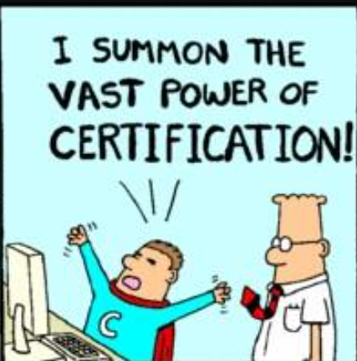

My DBA Journey AS Explained By A Data EnGINEER…
RAW
BASE
ENRICHED
CURATED
Notes:
My RAW Layer – See what I did with the Tiger, So I took over managing a numer of oracle development environments because things where bad, these environments had the Scott user with SYSDBA level rights with the default password set… getting some control over these environments led me too
My next step or BASE Layer – I was “rewarded” for my endeavours with a Junior DBA position in the an actual DBA team, they gave me SQL Server to look after as no one else wanted to do it, it was pre SQL 2000 so can understand that now, but I was ok with that some of the books I read on sql 6.5 at the time even showed me how to use cursor, Being the SQL guy was great, I got to decide how we secured the data, got to say no and it depends a lot and soon worked out the importance of a good backup and data integrity strategy and had maintenance plans to prove it!
But still I wanted to develop and understand SQL,
So following being made redundant my Enriched stage lead me to thinking about Microsoft certified and as a contractor decide to do a boot camp and got certified on SQL2008, but learning by doing was still my strongest skill, finding blogs forums helped up my skill level until finding the data community, My curated layer included regular learning attending many user groups and conferenced fuelled my passion for performance tuning and automation but also gave me the confidence to tackle Architectural challenges, take on system and process ownership and encouraged me to share what I’d learnt with my fellow DBA’s and developers

Slide 58

Then…
Notes:
So again I felt like I needed to change, I hadn’t worked in a ETL environment or worked closely Data so took an opportunity to work with the data warehousing team again with Oracle but also with SAP, the dogs making sense right
But this was an important step I got to model data, build out dimension tables and star schemas, got to my first taste of ETL tools using informatica and orchestration with UC4 he’s still not looking

Slide 59
The Journey
Server Admin
Accidental DBA
SQL DBA
Senior DBA
SAP BI
Data Engineering Consultant
Windows NT
Netware
Unix
Security
System maintenance
Networks
Storage
PL SQL
Shell Scripting
SQL
Backup and Recovery
Security
Data Integrity
SSIS
SSAS
SSRS
SAAS, PAAS, IAAS
Performance tuning
Process Definition & Ownership
Architecture
Warehousing
Data Integration
Data Modelling
Reporting: Power Bi Business Objects
Automation
ETL
Stakeholder Engagement
SAP HANA
Python
SQL
Spark
Azure
Streaming Orchestration
Agile & Scrum
Strategy
Architecture
Notes:
But every stage of my data journey has contributed in at least a small way to my current role, I may not have been an expert in all of the areas but lead to at least a partial understanding in many of the key area’s of data engineer which I work in now. Adding skills such as Python as well as Some more formalised softskills

Slide 60
Data Engineer vs DBA

Slide 61
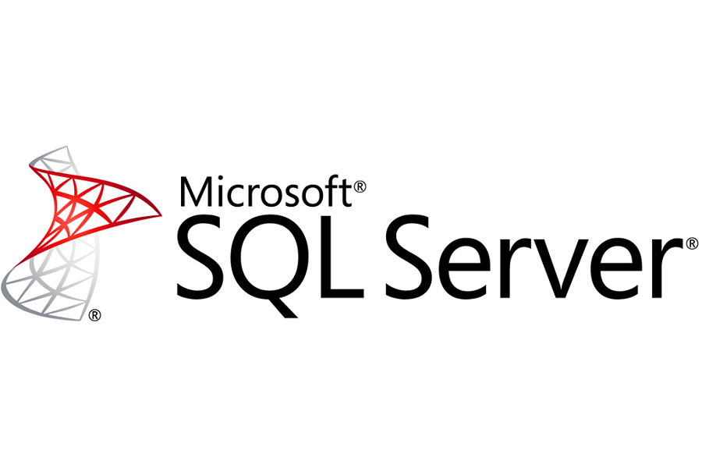







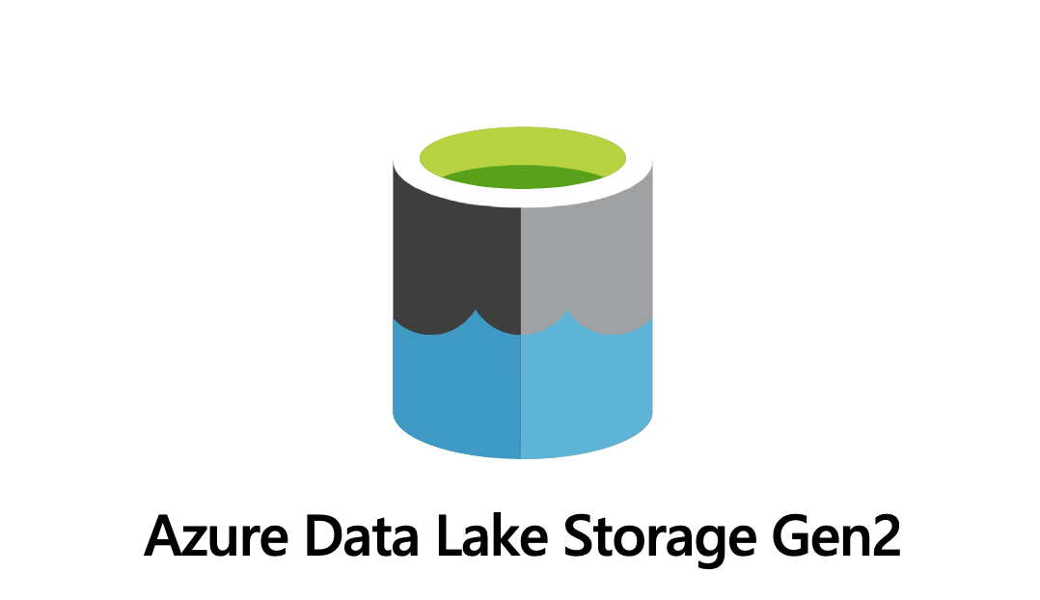
What you may be using today
DBA’s are heavily invested in Data and your skills reflect this
Relational
Cloud
Services
Programming
Notes:
As a DBA you’ll be coming from a very data orientated background, but lots of the technology and how they are used in data engineering is very similar, we don’t really use relational engines for data processing but they’re used in other ways such as configuration of the platform and the world of data still uses SQL, much of our what we do is in the cloud so using Azure, AWS or even GCP are all great skills to have

Slide 62
What Changes
DBA
Most DBA’s will work with relational platforms
High priority on the incoming data being correct shape and size
Thinking operationally how you manage the systems
Data Engineer
Data from and stored in structured and no-structured formats
How we make data useable
Think parallel, will it scale
Notes:
The main changes is a shift in your priorities
As a DBA you’ll be working with relational platforms, high on your priorities are things like ensure data integrity, making sure its efficient fast and safe, you’ll be thinking about how secure and safe the data is
Your focus for data engineering will change, the data still needs to be secure but your data won’t always be in the same size and shape, your thinking how do to make it useable and how to scale the platform

Slide 63
Soft skills you might not know you have
You can talk to tech’s
Engage with business
Explain why
Notes:
This may come as a shock but as DBA’s you will have developed some great soft skills despite saying it depends or no quite a lot
You like to know how thing work, more specifically you want to know where your potential problems are so you go and find out and you keep going until you know everything about where your data is so you learn technology and can talk to other technical groups
You’ve engaged with the business, those times when you talking to various departments about your DR plans and tests for example, you’ve identified key users for functional testing and you can explain why they need to do this without using jargon

Slide 64
A Software Engineers Journey
Notes:
Anna 5min

Slide 65

Where is all began
Notes:
When left school I wanted to be a photographer

Slide 66
The Journey
Lab Technician (photography)
Graphic Artist
Application Developer
Software Developer/
Engineer
Data Engineer
Data Engineering Consultant
Spark
BigQuery
Synapse
Kimball
Kappa
Delta
Lambda Architectures
Agile & Scrum
Python
DataOps and MLOps
Hanging around
in dark places
Adobe Software
XML
JavaScript
HTML
C#
SQL (Relational
Databases)
XML
JavaScript
HTML
C#
SQL (Relational
Databases)
XML
JavaScript
HTML
C#
SQL (Relational
Databases)
XML
JavaScript
HTML
C#
SQL (Relational
Databases)
*Warehousing
*Warehousing
*Warehousing
JSON
Scala
YML
NoSQL Databases
Kafka
JSON
Scala
YML
NoSQL Databases
Kafka
JSON
Scala
YML
NoSQL Databases
Kafka

Slide 67
Software Engineer to Data Engineer
Already had a lot of the core skillsets required
Used to working with CI (Continuous Integration)/CD (Continuous Deployment), IaC (Infrastructure as Code)
Brought Software standards and processes into Data Engineering

Slide 68
Data Engineering vs Software Engineering

Slide 69
The skill sets can be very similar, so what’s the difference?
OO Programmers are expected to know about Design Patterns, Functional Programmers are expected to know about Category Theory.
So on the same note a Data Engineer should know about the different Data processing and storage architectures, including:
Kappa
Delta
Lambda architectures
Star Schemas

Slide 70
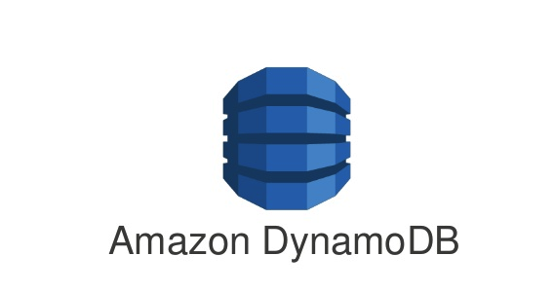





The skill sets can be very similar, so what’s the difference?
Data Engineers need to understand different Data store offerings, and when to use them, including:
Relational
Key Value
Graph
Document

Slide 71


The skill sets can be very similar, so what’s the difference?
Data Engineers need to know which compute offering to use and when, and where to host them including:
Kubernetes
Custom Application
Azure web app
Spark/Databricks
Event Driven Serverless Functions
Notes:
Hand over to ust

Slide 72
A Data Enthusiast’s Journey

Slide 73

A long time ago...
Notes:
A long time ago… I didn’t want to do the Kessel Run in less than 12 Parsecs, I wanted to be Indiana Jones
An archaeologist who has adventures and fights the bad guys

Slide 74
The Journey
Army
Data Analyst
Insight Manager
BI Consultant
Head of BI
Data Engineering Consultant
Getting cold, wet (often miserable) in lovely places…
SPSS
Python
Excel (lots of Excel)
Excel (even more Excel)
SPSS
SQL
R
SQL
SSIS
SSAS
SSRS
Power BI
Warehousing
C#
Agile & Scrum
Architecture
Management
Strategy
Warehousing
Excel (SO MUCH!!)
PowerPoint
Teams
SQL
SSAS
Power BI
Datazen??
Python
SQL
Spark
Excel
PowerPoint
Power BI
Agile & Scrum
Strategy
Architecture

Slide 75
Data Generalist to Data Engineer
Already had a lot of the core skillsets required
Used to working with ETL and BI Tools
Brought end-user perspective to Engineering
Notes:
Truth be told, I’m still a generalist with a healthy interest in Data Engineering – because it makes everything else work. And it presents a load of data problems which I love to solve.

Slide 76
How are we going to help
What is Data Engineering
The Tools and Technology
How we Got Here
Notes:
To hopefully get you started on you own journeys we’ll be breaking the session down into 3 sections
We’re going to introduce the role of the data engineering
We’ll introduce some of the tools and technologies we use and
And we’re going to show you just how accessible it is for other tech professions by telling you our own stories

Slide 77
Call to Action
Notes:
So what do you do now? This section is going to go through some of the resources available for you to skill up

Slide 78

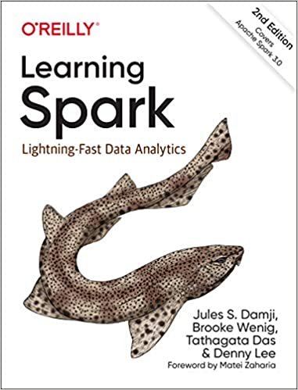
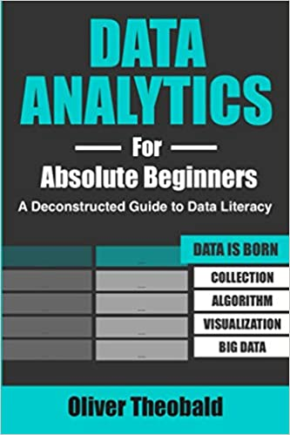
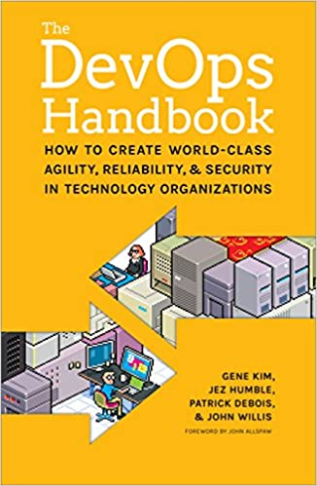
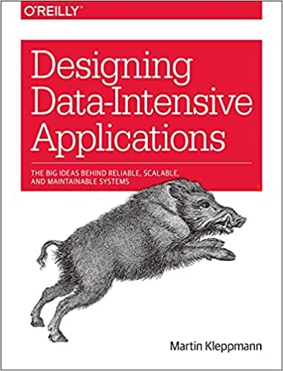
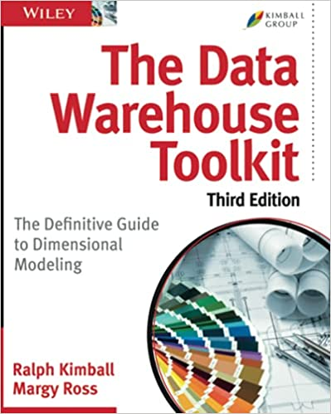

Books you should definitely read

Slide 79


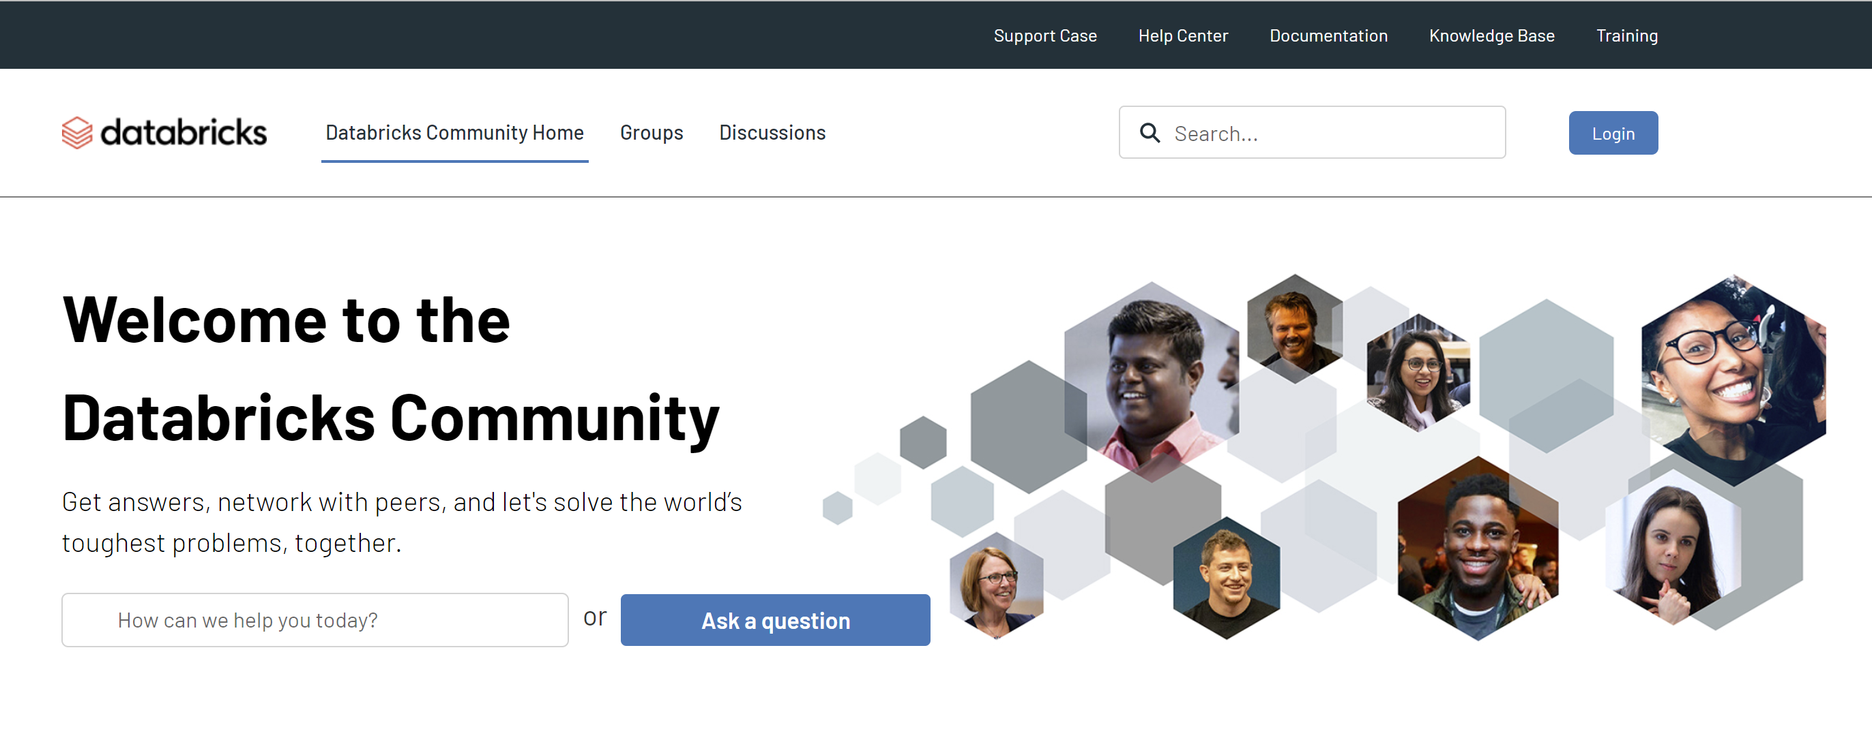

Websites for Help and Learn
www.cathrinewilhelmsen.net
community.databricks.com
sparkbyexamples.com
stackoverflow.com
And of course
www.advancinganalytics.co.uk

Slide 80




Video Links
https://www.youtube.com/c/AdvancingAnalytics
https://www.youtube.com/c/SeattleDataGuy
https://www.youtube.com/c/Databricks
https://www.youtube.com/c/BryanCafferky

Slide 81
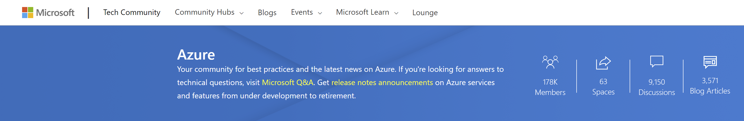

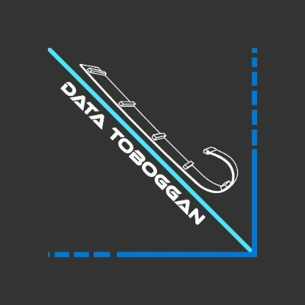



Use the Community

Slide 82
SQLBits Sessions Coming Next
Straight After this….
Kevin Chant, Kay Cordewener - Azure Data Engineering services used to analyze data (Room 9)
Just Blindbæk - Architectural blueprints for the Modern Data Warehouse (Room 12)
Then @ 17:10
Kamil Nowinski - Azure Data Factory - A deployment challenges (Room 12)
Craig Porteous, Chris Williams - "Cultivating the Catalogue" - Growing Data Governance with Azure Purview (Room 3)
Cathrine Wilhelmsen, Helle Normann - Lessons Learned: Implementing Azure Synapse Analytics in a Rapidly-Changing Startup (Room 7)

Slide 83
SQLBits Sessions Tomorrow
Ivan Donev - Practical Lakehouse implementation in the enterprise
Heini Ilmarinen - Less Clicking, More Coding! Data Platform Development Using Infrastructure as Code
Mike Dobing - Building the Lakehouse Architecture with Azure Synapse Analytics
Angela Henry - What is Azure Purview and Why Do I Need It?
Zach Stagers - Synapse Data Flows - Will Citizen ETL Replace the Data Engineer?
Falek Miah, Anna Wykes - Automate the deployment of Databricks components using Terraform
Bernhard Engleder, Wolfgang Strasser - Data Governance with Azure Purview - Theory, Customer Insights and Demos
Dustin Vannoy - Azure Data Engineer Skills for Success
Oliver Engels, Tillmann Eitelberg - Enterprise Scale Analytics - What's in it for me
Koen Verbeeck - The modern Cloud Data Warehouse - Snowflake on Azure
Ben Jarvis - Azure Container Apps for Data Engineers
Ajith Ramanath - Hitting Top Speeds with Spark SQL in Azure Synapse
Piotr Mucha - Run your SSIS packages in Azure Data Factory

Slide 84
SQLBits Sessions Grab the Recordings
Luke Moloney - The fundamentals of building a lakehouse with Synapse
André Kamman - Building your first Metadata Driven Azure Data Factory
Nick Baladi, Dave Draffin, Martyn Bullerwell,Andrew Isenman - Heathrow’s Data Transformation, How to rapidly build out a data engineering function
Simon Whiteley - Lessons in Lakehouse Automation
Andy Cutler - The Dream Team: Synapse Analytics Serverless SQL Pools and Pipelines
Mike Diehl - Azure DevOps Release Pipelines for SQL Databases, Azure Data Factories, and Analysis Models
Jean Joseph - From Housekeeping to Data Engineer - My journey to find my passion
Niels Berglund - ksqlDB - The Real-Time Streaming Database
Simon Whiteley - Bringing Data Lakes to your Purview
Gavin Campbell, Edward Allen - Data Engineering the Hard Way: Developing Spark Applications on Kubernetes
James Serra - Data Lakehouse, Data Mesh, and Data Fabric (the alphabet soup of data architectures)
Paul Andrew - Creating a Metadata Driven Orchestration Framework Using Azure Data Integration Pipelines

Slide 85
SQLBits Sessions Grab the Recordings
Kevin Chant, Sander Stad - Github and Azure DevOps Duet - SQLBits edition
Ust Oldfield - Implementing a Data Quality Framework in Purview
Daniel Harrington - Leveraging Apache Spark for Efficient Data Encryption at Scale
Henk van der Valk - Lessons learned from managing Azure Data platforms! Put your data hat on!
Paul Andrew - The Evolution of Data Platform Architectures in Azure - Lambda, Kappa, Delta, Data Mesh
Evangeline White, Gaurav Malhotra - Unified Data Governance with Azure Purview
Erwin de Kreuk - Lake Database with Database Template and Mapping Data with Azure Synapse Analytics
Gaurav Malhotra - Self Service Data Access Provisioning With Azure Purview
Matthew Roche - Roche's Maxim of Data Transformation
Vanessa Araújo - Spring clean your data lake with Database Templates for Synapse Analytics
Dr. Victoria Holt, Erwin de Kreuk, Wolfgang Strasser - Data Governance with Azure Purview - Ask the Experts

Slide 86

Ust Oldfield
Principal Advancing Analytics Consultant specializing in Data Engineering, Analytics and Strategy.
Over 10 years’ experience, most recently working within the Microsoft Data Platform.
Data and Tech enthusiast – looking to make data accessible to all
Ust-oldfield
@UstDoesTech

Slide 87


Anna Wykes
Senior Advancing Analytics Consultant specializing in Data Engineering, DevOps & Cloud.
Over 16 years’ experience, most recently working within the Microsoft Data Platform, Scala, Kafka and various cloud tech
Help to run local Data Meetup “Data Bristol”, and also help out
at local Code Clubs
BSc in Multimedia Computing & Business, and a HND in Visual Communication
anna-maria-wykes
@annawykes

Slide 88

Michael Robson
Senior Advancing Analytics Consultant specializing in Data Engineering, Analytics and Strategy.
This is was my first presenting session, anywhere!
Was a DBA for 20 years
Been involved in the Data Community for over 10 years, setup Data Platform Meetup “Newcastle DPaC”, help organise Data Relay and have been helper at SQL bits since 2015
michaelrobsonuk
@heymiky

Slide 89



Please Leave Feedback
https://sqlb.it/?7129

Slide 90
CUT & RUN

Slide 91

JOIN US

Slide 92
Why Data Engineering?

Slide 93
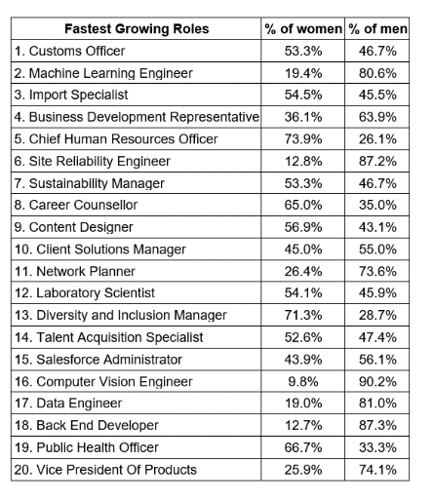
Hottest Industry
Notes:
You might see roles like Machine Learning Engineer above the Data Engineer, but they can’t do anything without data engineering
But let’s stop for a minute to talk about representation… Or lack of it

Slide 94
It’s FUN
Notes:
Though at times it’s like wrestling a bear and an alligator at once

Slide 95
Accessible from Existing Role

Slide 96
Modern Data Warehouses

Slide 97
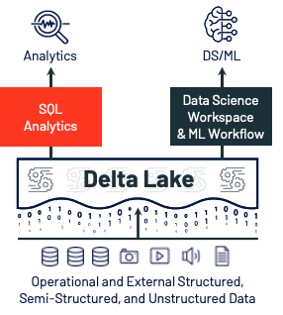

Databricks SQL Analytics

Slide 98
A Data Engineer’s Tool Belt

Slide 99


What Languages do we use?

Slide 100


Cloud Service Providers

Slide 102
Cloud Technology: Data Processing, Compute and Orchestration

Slide 103
Cloud Technology: Data Storage
Notes:
Partitioning, sorting, security

Slide 104
Do you have to use Cloud?
No!
There’s a lot of “non cloud” Tech, and/or tech that can be hosted in any Cloud provider

Slide 105
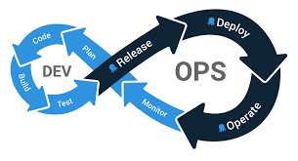





DevOps
DevOps is a set of practices that combines software
development and IT operations to get solutions into production
Notes:
DevOps for data science is hard, keeping models fresh, productionising models

Slide 106
Use The Skills You Have

